Slide 1



Foreign Direct Investment Analytics
- Preet Jitendra Jain

Slide 2
PROJECT DETAILS
Project Title | Entertainer Data Analytics
Technology | Data Science
Domain | Sports
Project Difficulty Level | Advanced
Programming Language used | Python
Tools Used | Google Colab, Power BI, Excel, Canva

Slide 3


PROBLEM STATEMENT
To understand the Foreign direct investment in India for the last 17 years from 2000-01 To 2016-17. This dataset contains sector and financial year-wise data of FDI in India
Sector-wise investment analysis Year-wise investment analysis.
DATASET INFORMATION
Investment is a game of understanding historic data of investment objects under different events but it is still a game of chances to minimize the risk we apply analytics
to find the equilibrium investment.

Slide 4
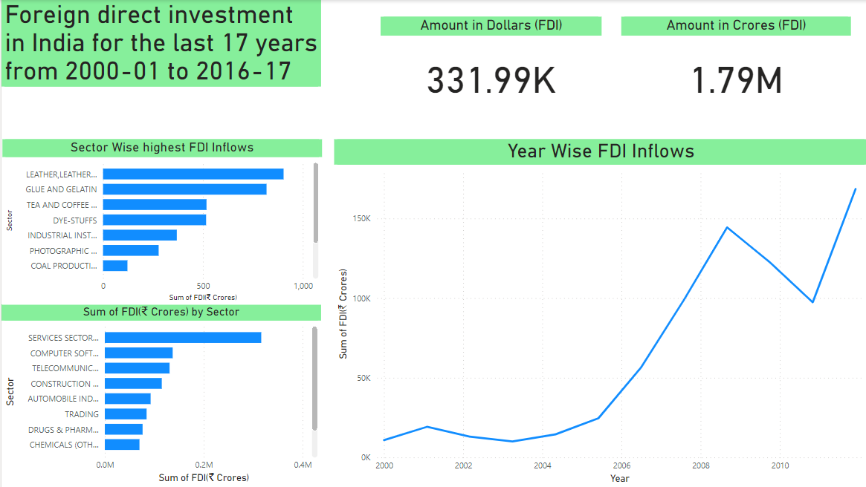

Slide 5

Key Performance Indicator (KPI)
Sector Wise highest FDI Inflows
Sum of FDI (in crores) Based on Different Sectors
Amount of FDI (in Crores)
Amount of FDI (in Dollars)
Inflows of FDI based on different years

Slide 6
Thank you very much!

